Slide 1
K-means clustering

Slide 2
I. Introduction
Context
Clustering represents the task of grouping a set of objects in such a way that objects belonging to one cluster are more similar to each other than to objects from other clusters.
K-means clustering is a popular unsupervised machine learning algorithm widely used in image processing and computer vision. In the context of colored images, K-means clustering is employed to group similar pixels based on their color values, thereby partitioning the image into distinct clusters.

Slide 3
Specifications
The project is developed in Visual Studio, using the open source library OpenCV.
Objectiv
The main objective of the project is to partition the colored image into K distinct clusters by assigning each pixel to the cluster with the nearest mean color.

Slide 4
II. Definition of terms and problem
This project, uses the RGB and HSV color spaces to represent images, where each pixel is a unit with specific red, green, and blue color values. The objective is to implement the K-means clustering algorithm to group pixels into clusters based on their color similarity. Clusters are defined as sets of pixels with similar color characteristics. The algorithm aims to minimize the intra-cluster variance. The goal of the project is image segmentation by leveraging K-means clustering to identify and distinguish regions of interest within the image.

Slide 5
III. Theoretical description of the method
Main steps needed to be followed for implementing K-means:
Data preparation
In this step, the image is processed such that to compute the set of data points needed as input for the algorithm
Initialization
In this step, K random clusters are selected from the set of input points.

Slide 6

Assignment
Each point from the data set is assigned to the closest cluster center found so far. A membership function will be introduced for each point and will take the value of the index of the closest cluster (L[i] will return the cluster of the $i^{th}$ point).
Update
The clusters are recalculated based on the membership function. Each cluster value will be updated with the mean of the points belonging to that cluster.
Halting condition
The membership function is also used to determine when the algorithm should stop its execution. If there is no change, from one iteration to another, in the membership function, then the algorithm can be halted.

Slide 7
IV. Implementation description
The following functions were implemented for achieving the goal of the project:
Data preparation function
The function for data preparation takes as input the colored image and returns the set of data points as a Mat structure. At first, the initial image is converted to HSV color space. Then, the set of data points is computed by going through each pixel and saving its color intensities and coordinates. Each row from the output matrix represents a pixel.
Distance function
This function calculates the Euclidian distance between two row matrices and will be used in the Update step of K-means.

Slide 8
K-means function
This is the function that implements the K-means algorithm. It takes as input the data set matrix and the number of clusters K.
The first step of the algorithm is initialization of the clusters. K clusters will be stored in a Mat structure and will be randomly selected from the data set using the rand() function. A verification is done in order to assure that the clusters are distinct.
The next step of the algorithm is assignment. This step defines a vector L that maps points to their clusters. For each point in the data set, the closest cluster is identified and stored in L (L[i] = c => point I belongs to center c). The identification of clusters is done using the distance function previously described.

Slide 9
In the update step, for each cluster, the mean of the points belonging to the cluster is computed and the values from the Mat of clusters will be updated according to the computed means.
The last step represents the halting condition. For this step a new vector L2 is introduced that represents a copy of the vector L. In each iteration L and L2 are compared and when no change is detected between them, the algorithm stops its execution and returns a pair structure containing the membership function L and the Mat of clusters C.

Slide 10
Main function
This function loads the colored image, calls the data preparation function on this image. After the set of data points is computed, the function corresponding to the K-means algorithm is called to determine the membership function and clusters for the image.
The clustered image is created using the output of the K-means function. Before displaying the resulted image, the image is converted back to BGR color space.

Slide 11
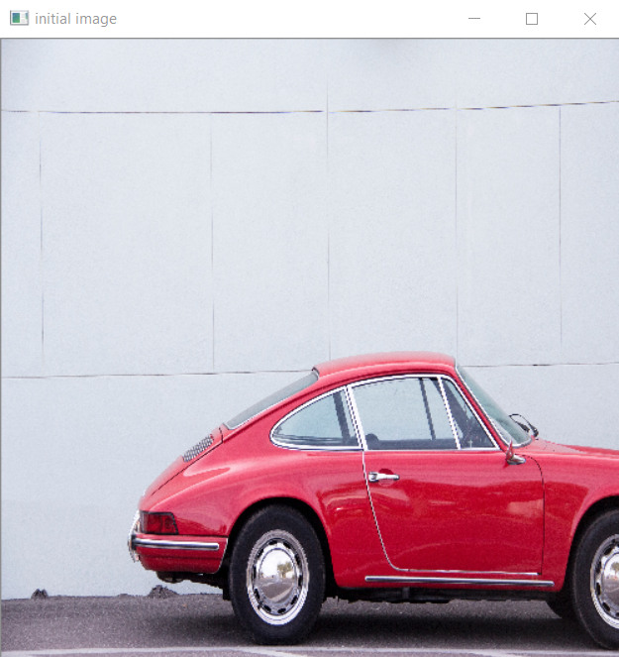
V. Results
The implemented algorithm was tested on 10 sample images with different K values.
Sample image 1

Slide 12
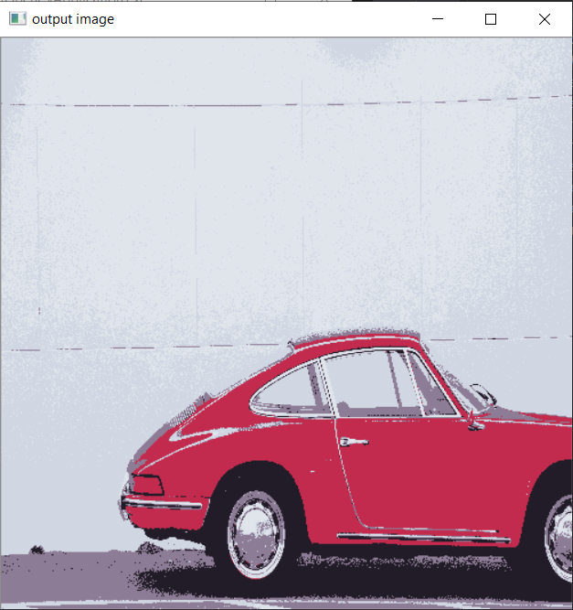
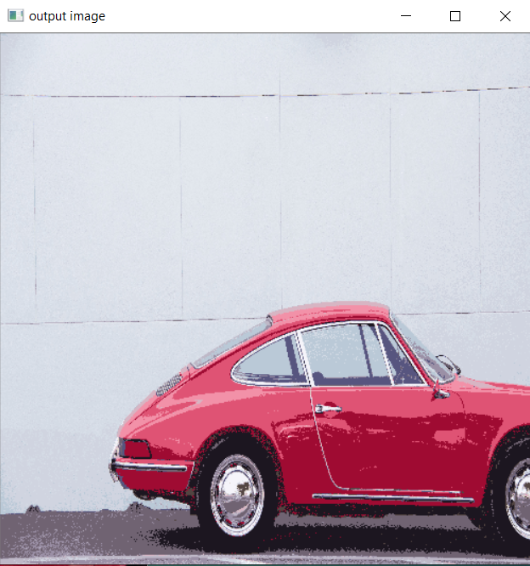
K=10 K=35

Slide 13
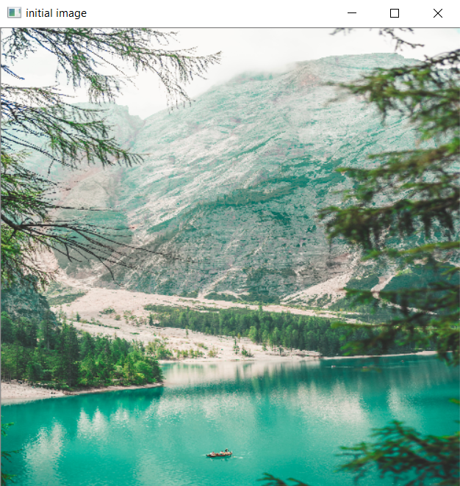
Sample image 2

Slide 14
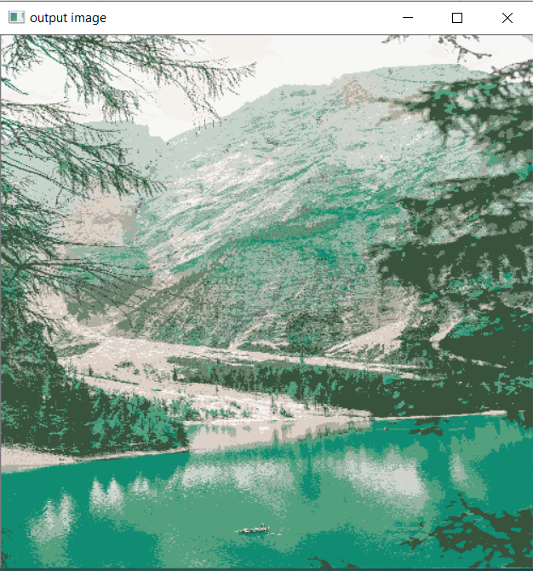
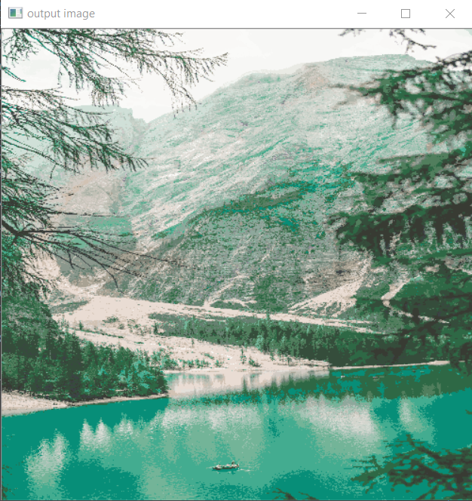
K=15 K=40

Slide 15
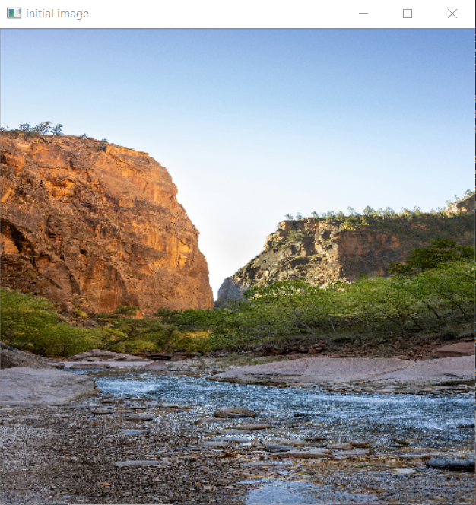
Sample image 3

Slide 16
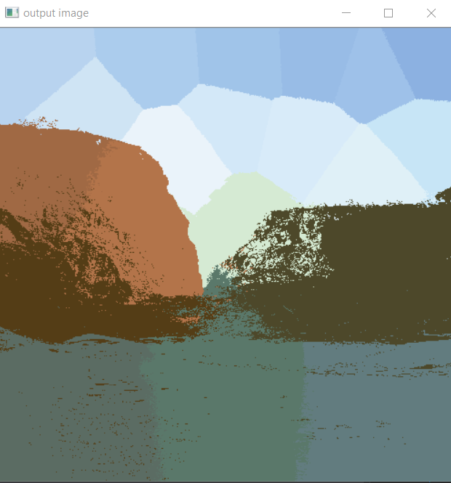
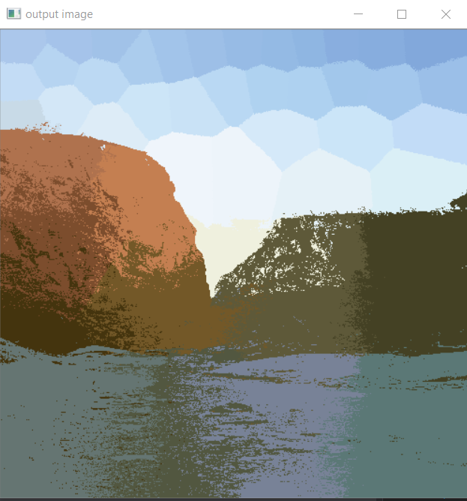
K=20 K=45

Slide 17
VI. Analysis on results
When the number of clusters is small in a K-means clustering algorithm applied to an image, it tends to result in fewer distinct color regions. Some effects of using a small number for K can be observed on the output images:
Color Compression: Regions of similar colors are represented by a single cluster centroid color. The resulting image will have fewer unique colors compared to the original.
Loss of Detail: The algorithm tends to merge pixels with similar colors into the same cluster. This can lead to a loss of fine details in the image, especially in areas with subtle color variations.

Slide 18
Posterization: Posterization occurs when the number of clusters is insufficient to represent the full range of colors in the image. This results in a stylized, cartoonish appearance with visible color boundaries between regions.
Over-Smoothing: A small number of clusters may cause the algorithm to oversimplify the color distribution, leading to over-smoothing. Regions that originally had nuanced color transitions may appear more uniform.
Color Dominance: The dominant colors in the image will be well-represented by the cluster centroids, while less dominant colors may be neglected.

Slide 19
VII. Conclusion
In summary, this project demonstrated the effective use of K-means clustering for image segmentation. By leveraging the algorithm in the RGB to HSV color space, we achieved meaningful clusters representing similar color patterns. Through careful evaluation and visualization, we identified optimal cluster configurations. The project showcases the versatility of K-means clustering in extracting valuable information from colored images, setting the stage for its potential applications in various computer vision contexts.

